Slide 1
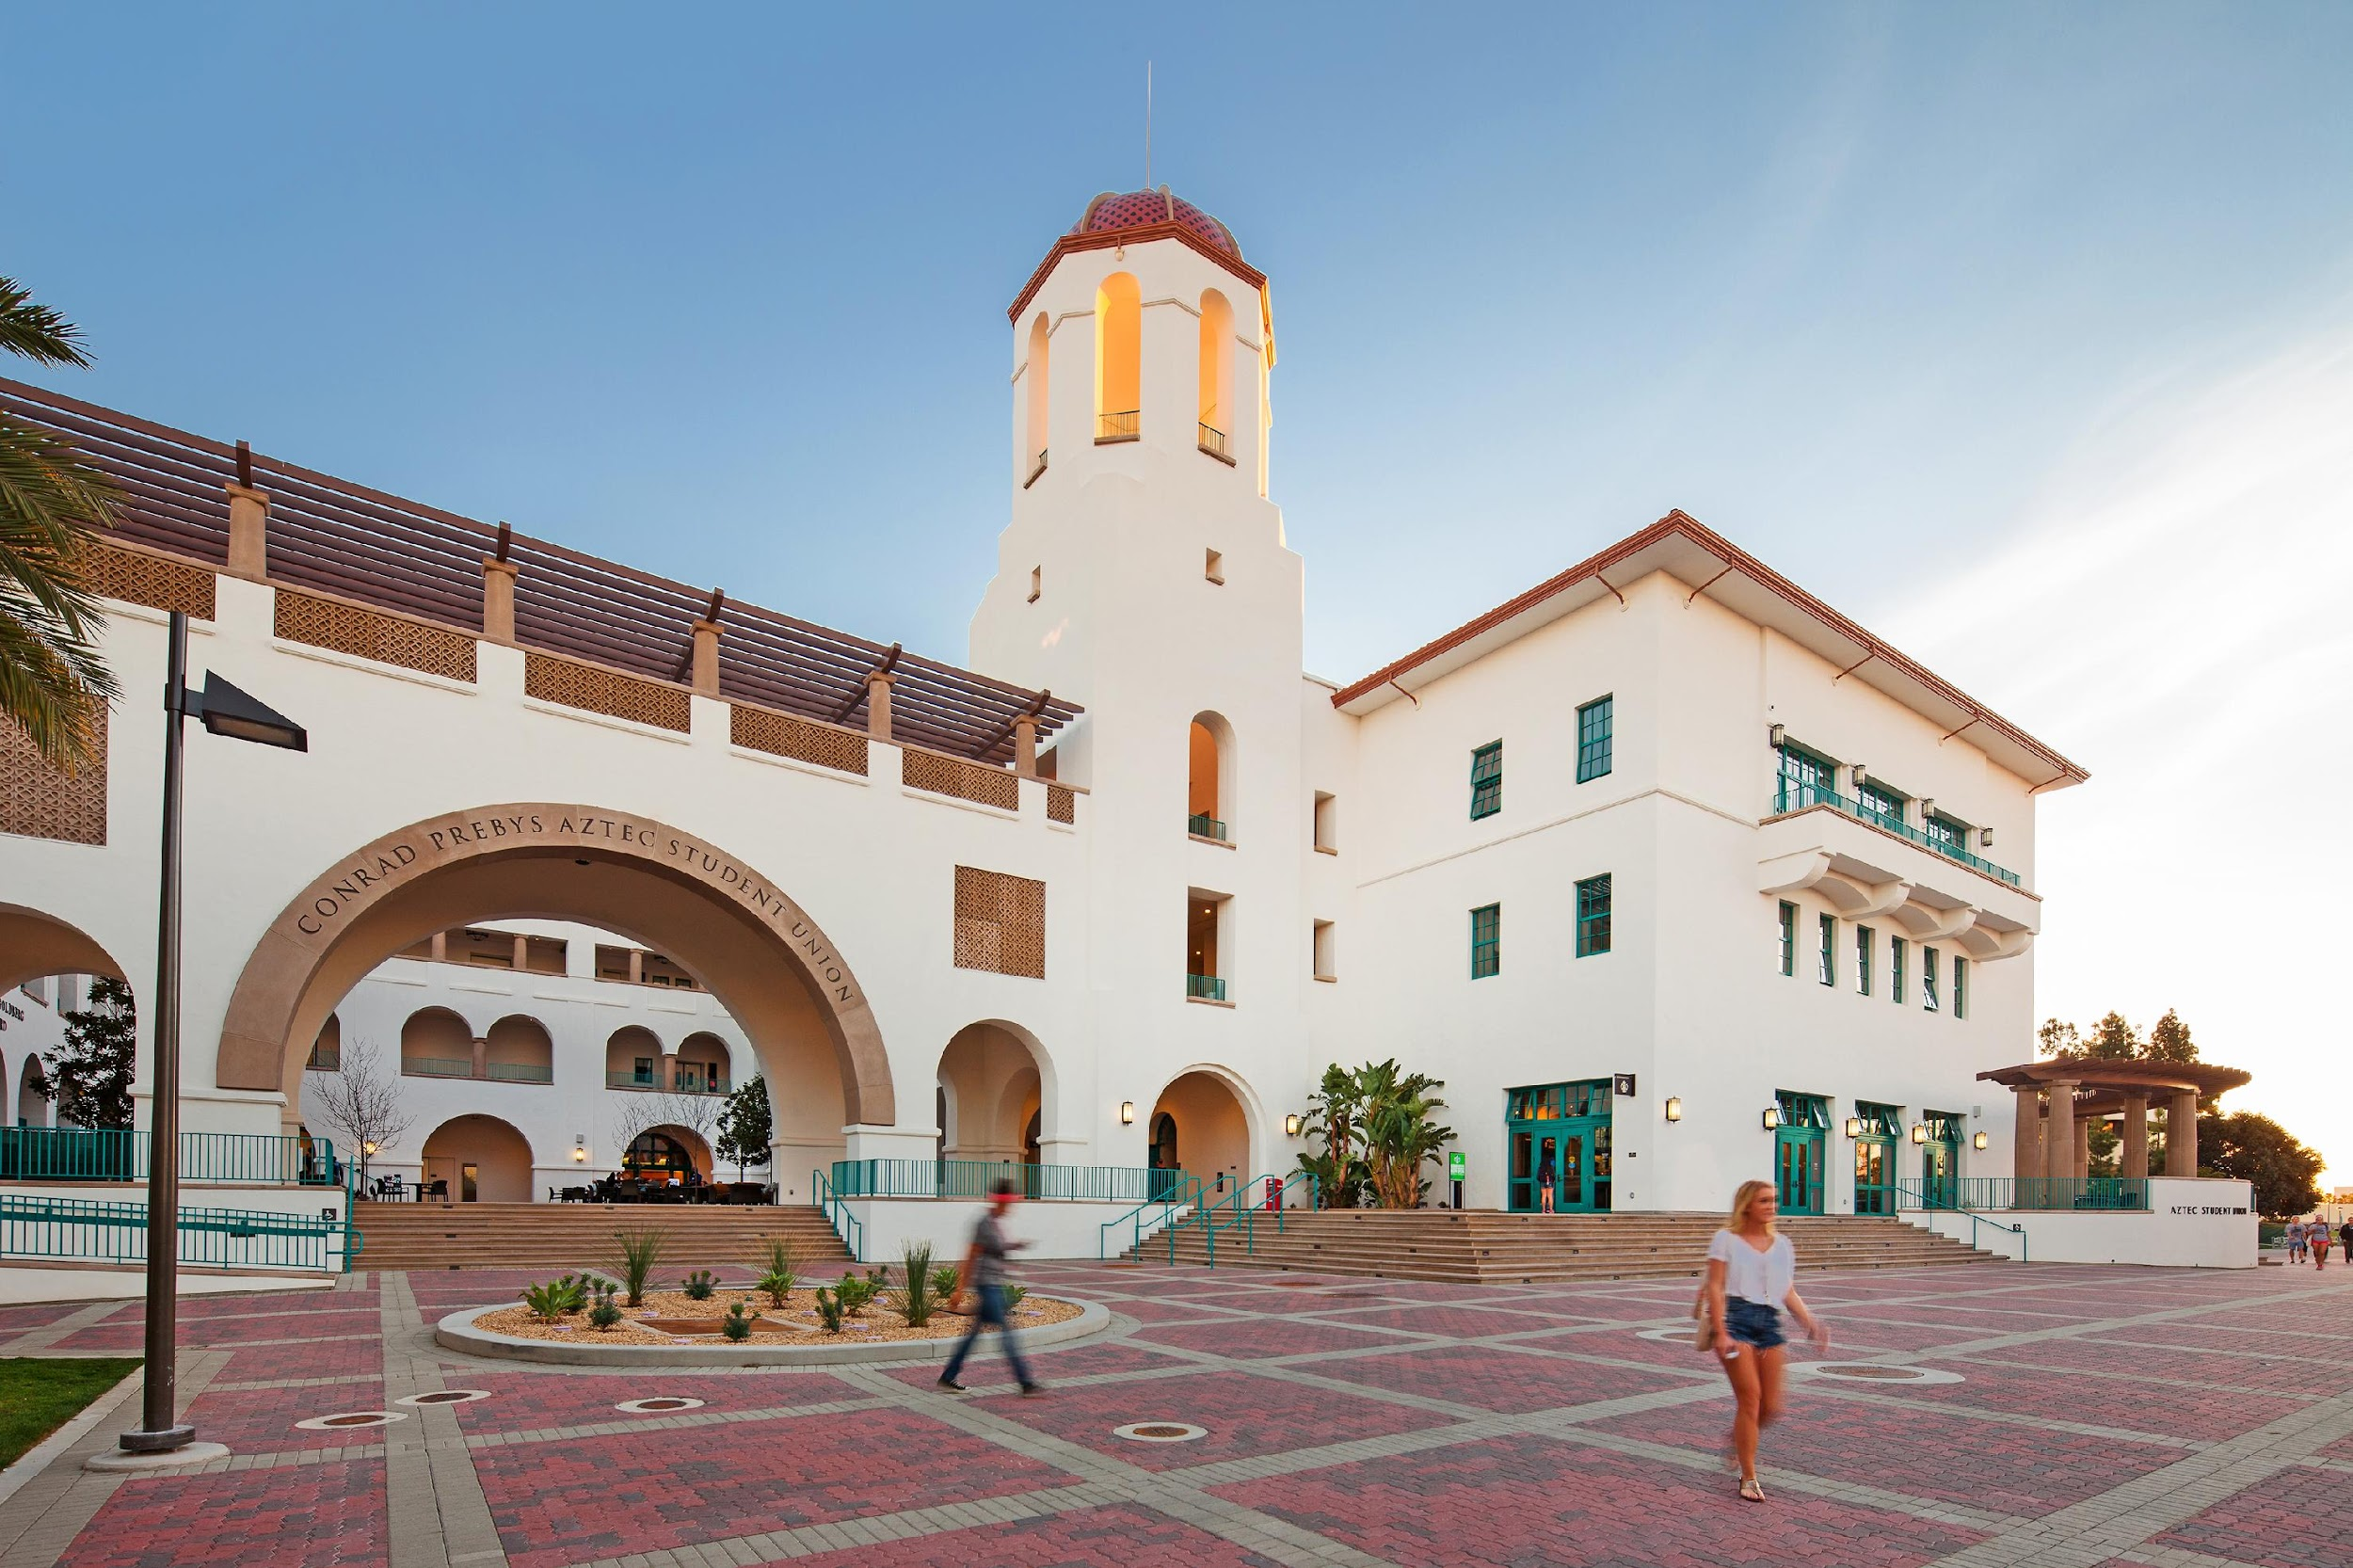
Fowler Graduate Orientation
August 18, 2023

Slide 2
Fall 2023 New Students
Programs | Intl | Domestic, Non CA | CA Resident | Grand Total
Accounting | 1 | 0 | 17 | 18
MSBA-FTP |  |  | 5 | 5
MBA | 13 | 16 | 115 | 144
Cybersecurity Mgt | 3 |  | 6 | 9
Global Business Development | 8 | 1 | 8 | 17
Information Systems | 23 | 1 | 3 | 27
Grand Total | 48 | 18 | 154 | 220
Notes:
Total Applicant: 839
Total Admitted: 398
Admitted rate=47%
Total Intent to Enroll: 220 Rate of international student/total=48/220=22%

Slide 3
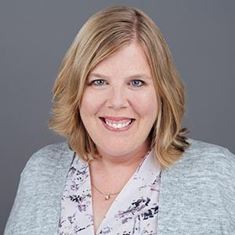
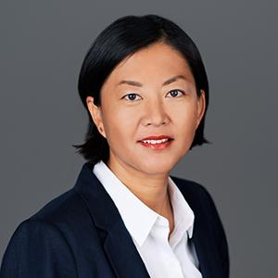
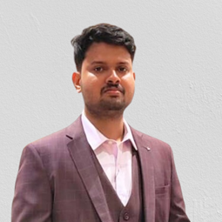
the Fowler Graduate Programs Team
Diane Coning, M.Ed.
MBA advisor
Dr. Congcong Zheng
Graduate Director
Amanda Yousif, M.Ed.
MSA MSIS Advisor
Ramothaman Ramesh, MBA candidate, student assistant

Slide 4
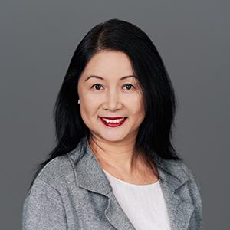
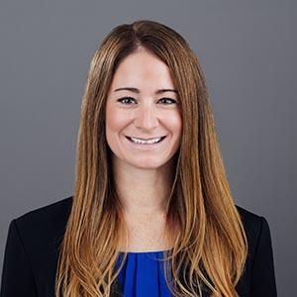
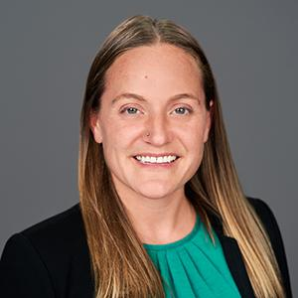
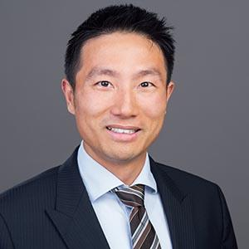
Faculty Graduate Advisors - MSA
AIS (N-Z)
Dr. Rebecca Perols
Taxation
Dr. Amanda Marino
AIS (Last Name A-M)
Dr. Valerie Li
Financial Reporting
Dr. Jeff Wang
Not pictured: BMAcc Faculty Advisors

Slide 5
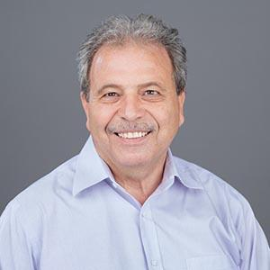
Faculty Graduate Advisor - MS-FTP
Dr. Kamal Haddad

Slide 6
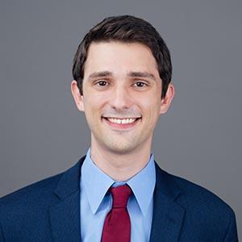
Faculty Graduate Advisor - MSIS
Dr. David Goldberg

Slide 7
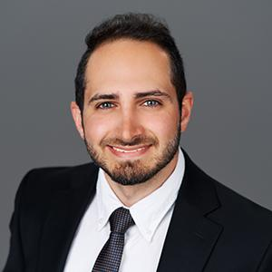
Faculty Graduate Advisor - MSCM
Dr. Morteza Safaei Pour

Slide 8
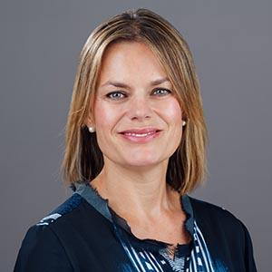
Faculty Graduate Advisor - MSGBD
Dr. Martina Musteen

Slide 9
Fowler Graduate Orientation
August 19, 2023

Slide 10
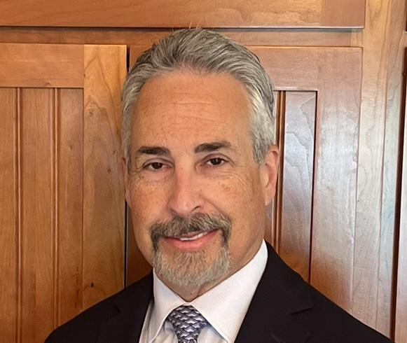
Welcome Remarks
Dean Dan Moshavi
Thomas and Evelyn Page Dean

Slide 11
Juli Moran
San Diego Office Marketplace Leader
Managing Director, Life Sciences

Slide 12
Business Chemistry
Learning
Career
Agility
Strategy
Professionalism
Consulting
Wardrobe
Advisory
Business
Reputation
Capabilities
Networking

Slide 13
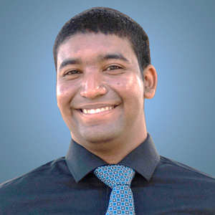
The Career Management Center Team
Tina Tan, M.A.
Director
Michelle Svay, M.A.
Career Development Specialist
Greg Tanneberger, J.D.
Professional Development and External Relations
Daniel Nieto, M.S.
Career Development Specialist
Notes:
Tina

Slide 14
What is #FowlerReady?
Fowler Graduate students must
Act with integrity, competence, diligence, respect and in an ethical manner with faculty, staff, students, employers, and colleagues
Place utmost importance in academic integrity and honesty and respect others’ intellectual property and individual work
Respect instructional and scholarly activities and avoid conducts that distracts or intimidates others in an instructional setting and other normal university activities
Adhere to the Student Conduct Code as outlined in CSU Executive Order 1098 (a section is reproduced in the Catalog)

Slide 15
What is #ProfessionalReady?
Courteous, respectful and clear in oral and written communications
Respond timely to your emails
Separate the problem from the emotions

Slide 17
Classified Standing
Have met all university and department requirements upon admission
Conditional Standing
Students admitted conditionally have not met all university or department requirements for admission – this is often due to deficient GPA or students having three-year undergraduate degrees
“Earn term GPA of 3.0 for 6 units”
Classified vs. Conditional
Notes:
conditional students are yet to be classified as a graduate student

Slide 18
During the semester your condition is due:
Communication from Graduate Studies and/or the Registrar
Reminder of your conditional status
Requests you complete Change of Status form
Warns of FUTURE registration holds
Tempting to initiate the Change of Status form right away
Have to wait for grades to post
Graduate Staff Advisors submit the form!
Conditional Admission

Slide 19
Access course syllabi, professor’s contact information, class assignments, course readings
Include your ID Number in all communications with us
Communications from Graduate Business Programs and Career Management Center
my.SDSU and Canvas

Slide 20
Website: https://registrar.sdsu.edu/calendars
Important Dates:
August 20—Last day to withdraw for fall semester and receive a full refund (less administrative fee if applicable). Last day to pay tuition and fees without penalty
August 21—First day of classes
August 27—Last day of wait list auto-enrollment. After this date, enrollment in open seats is not automatic or guaranteed.
September 1—Schedule adjustment deadline. Last day to add, drop, or change grading basis (7:59 p.m. deadline).
Academic Calendar

Slide 21
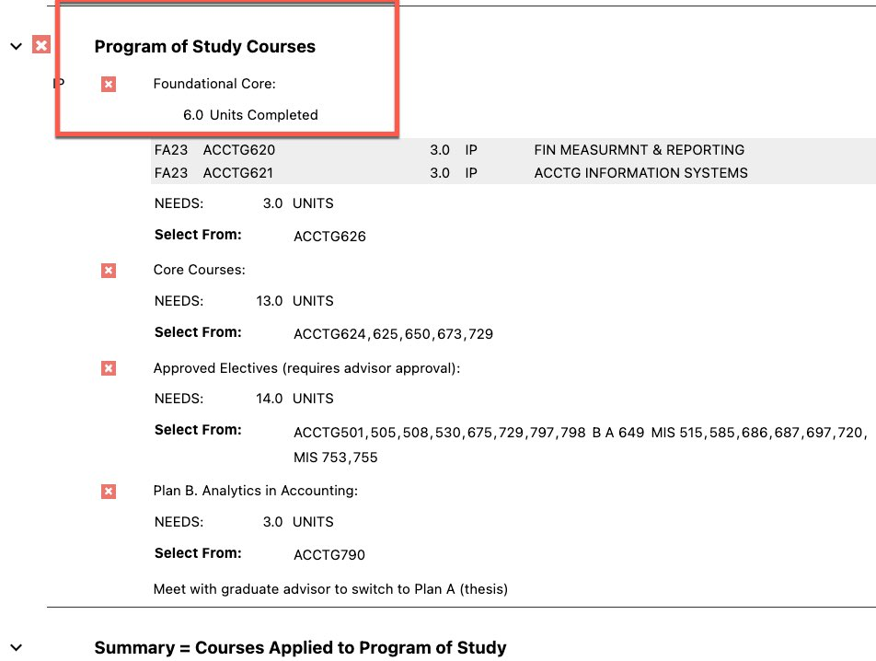
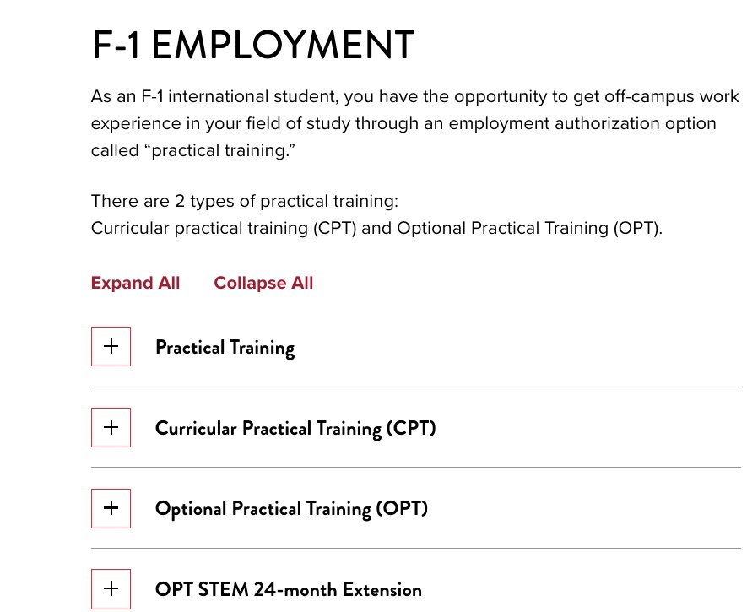
Three key resources
Degree Audit
(thru my.SDSU)
International Student Center CPT and OPT
On Campus/Off campus jobs
Notes:
degree audit: what am I doing

Slide 22
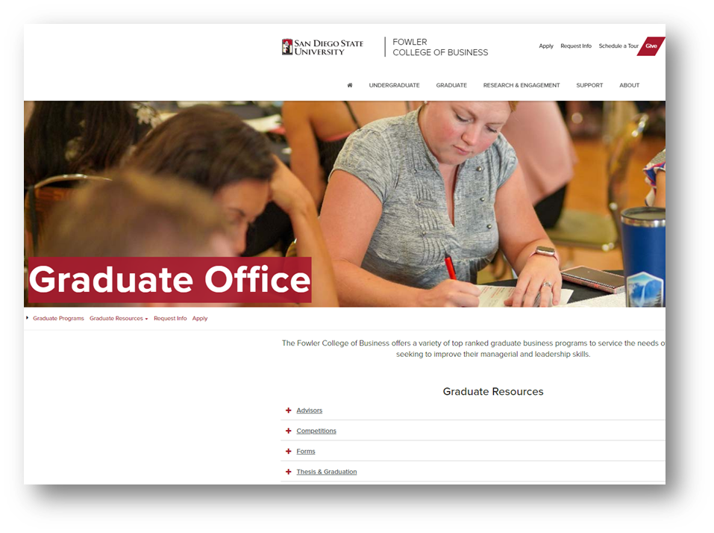
https://business.sdsu.edu/graduate/grad-advising
Important Resources
Our contact information
More info on student standing
How to follow your Degree Evaluation
Fee Waiver forms
CPT info
Culminating Experience info
Links to other resources and forms
Resources for Current Students

Slide 23
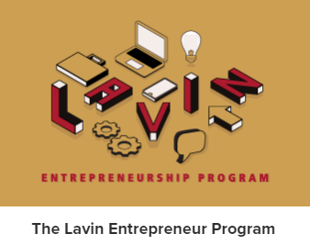
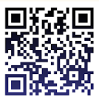
STUDENT ORGANIZATIONS HIGH IMPACT PROGRAMS
Business
& Technology Club
Get Involved

Slide 24
Lamden Hall 448
619-594-8073
gradbusiness@sdsu.edu
Diane Coning
dconing@sdsu.edu
Amanda Yousif
ayousif@sdsu.edu
Contact Us

Slide 25
Stay Connected Online
Learn about Academic, Social, and Professional Opportunities on our Social Channels!
Follow us on LinkedIn @sdsufowler
Like us on Facebook @sdsufowler
Follow us on Instagram @sdsufowler
Follow us on Twitter
@sdsufowler
Follow us on TikTok
@sdsufowler
Connect with us! | @SDSUFowler

Slide 26
International Student Center
Welcome New
Fowler Graduate
F-1 International Students!
Notes:
AR

Slide 27
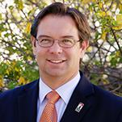
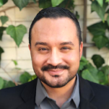
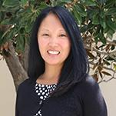
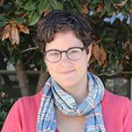
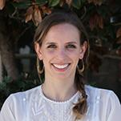
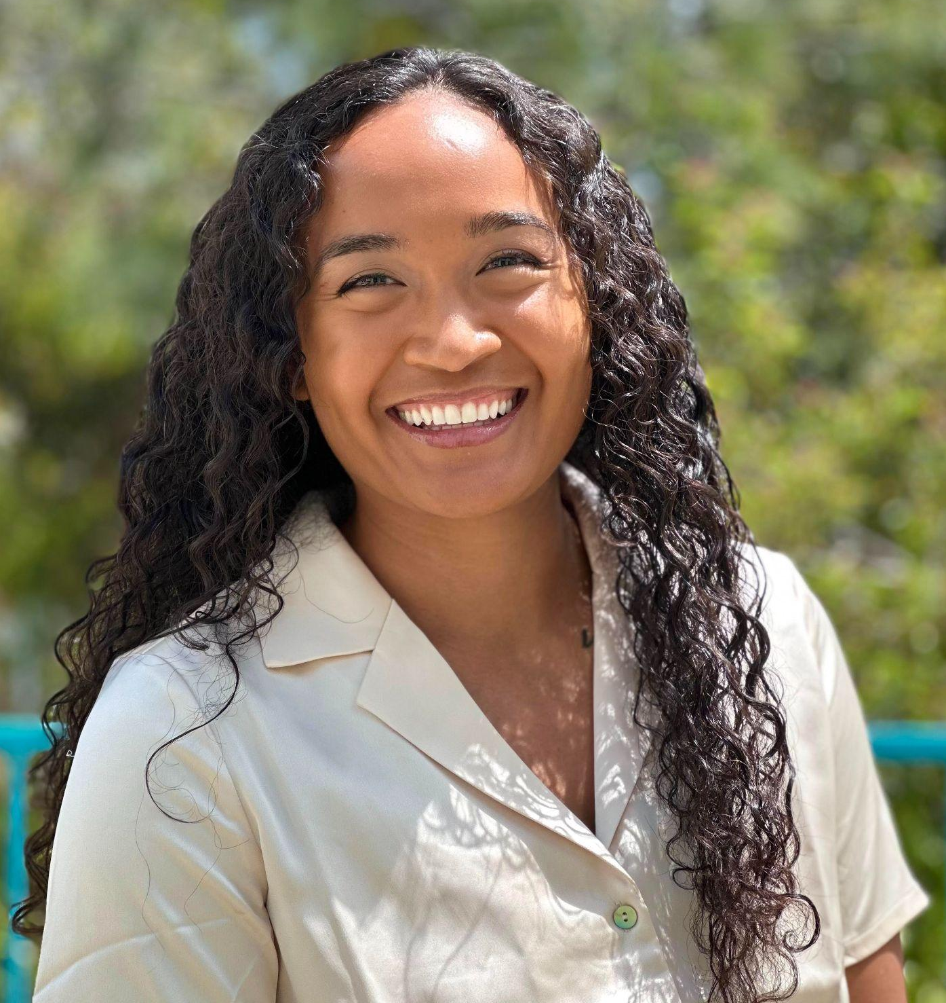
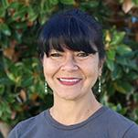
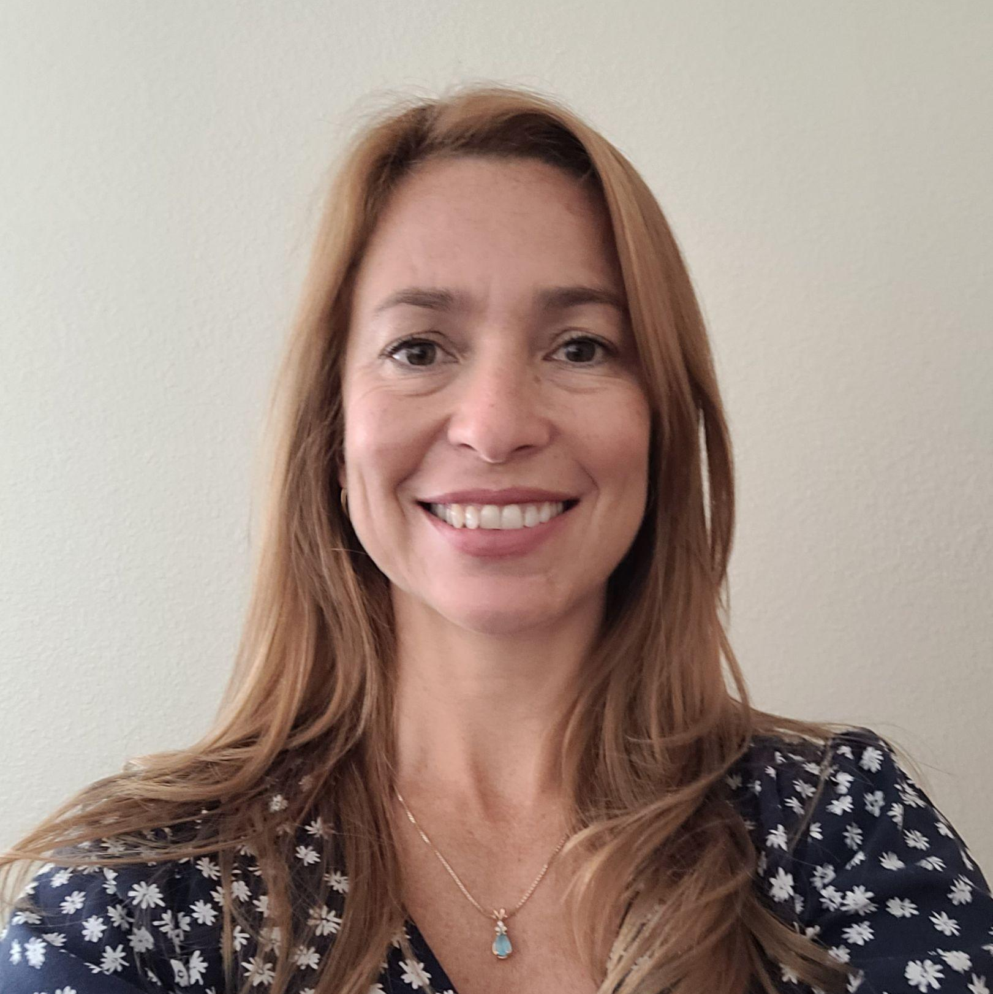
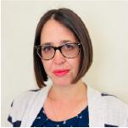
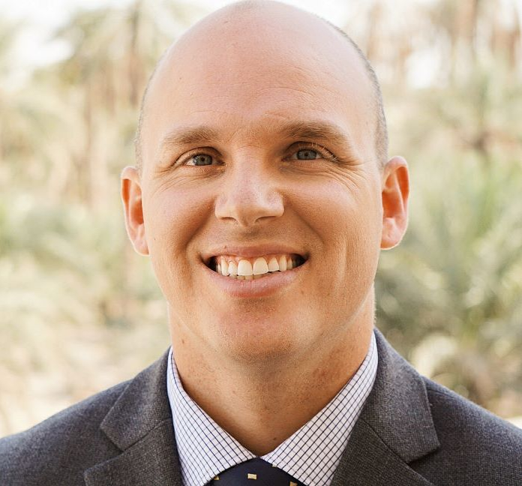
ISC Staff
Noah Hansen
Senior Director
Ricky Paniagua
Assistant Director
Lisa Lyons
Sr. Int’l Student Advisor
Laura Ribitzky
Int’l Student Advisor
Isabel Martorell
Int’l Student Advisor
Clarissa Fontanilla-Fajardo
Int’l Student Services Advisor
Alison Peppers
Intake Coordinator
Vanessa Fennell
Sponsored Student Coord.
Alana Ritchison
Int’l Student Transition Coord.
Barry Fass-Holmes
SEVIS Coordinator
Michael Moak
Int’l Student Retention Coord.

Slide 28
ISC Services Access
Office Hours
In-person office hours: Monday to Friday, 9:00am-4:00pm
Virtual Office Hours (Live Chat): Monday - Friday: 9:00am-12:00pm // 1:00pm-4:00pm Except Holidays
Open Advising Hours
3 days per week
Virtual and in-person options
10-minute consultation / no appointment
First-come, first-served
Visit ISC Calendar for Open Advising Schedule
When contacting the ISC: Always provide your RedID
Online Document Requests
I-20 Program Extensions, Work Authorization, Travel signatures, etc.
Submit via online request forms
Appointment Scheduling, Workshops, Cultural and Social hours, and more….
Visit sdsu.edu/isc for further details of all services offered to international students

Slide 29
Maintaining Your F-1 Status

Slide 30
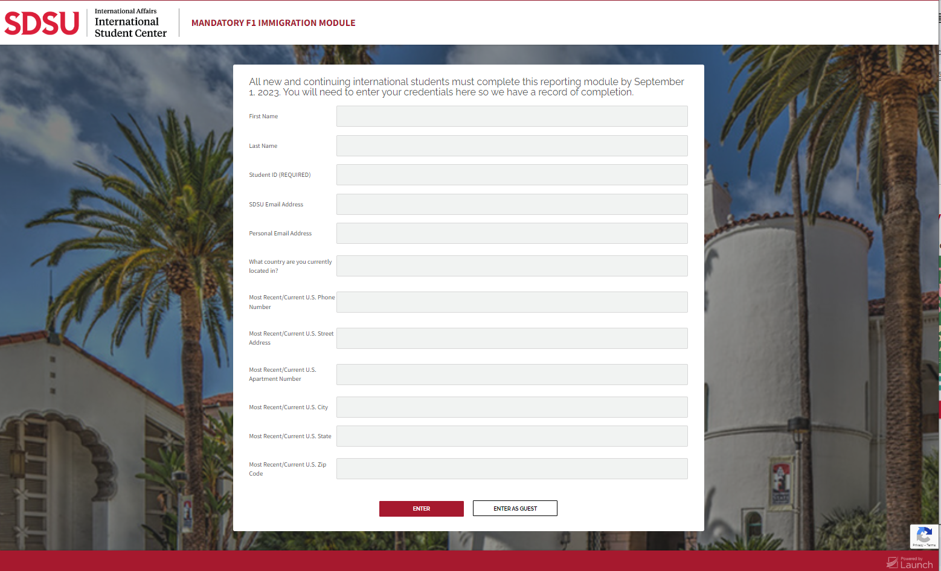
F-1 Online Orientation - MANDATORY
Deadline: September 1st
Enter using your Name, RedID & SDSU email
NOT as “Guest”
Let’s review a few important rules from this orientation
Notes:
Hopefully you have all completed your F-1 Online Orientation, if you have not, please complete it tonight!

Slide 31
Required: Full-Time Enrollment
> or = 9 units/semester
Maximum one online class per semester (usually 3 units)
Hybrid classes = in-person for immigration purposes.
Before withdrawing from classes in middle of semester, talk with an ISC Advisor – can affect F-1 status
Enrollment not required during the summer and winter breaks

Slide 32
Reduced Course Load
An RCL (less than full-time) allowed for certain reasons via online request
Some require meeting w/ISC Advisor to determine eligibility
Submit request by Schedule Adjustment (add/drop) Deadline
ISC must PRE-APPROVE to avoid immigration violation
More info on ISC’s Reduced Course Load webpage

Slide 33
Employment
On-Campus Employment:
Available to all F-1 students now!
Part-time (max. 20 hrs/wk) when school in session
Full-time (>20 hrs/wk) allowed during official school breaks
Off-Campus Employment/Internship:
Eligible after 2 semesters in F-1 status here (unless SEVIS transfer)
Must receive permission from the ISC or U.S. Immigration
Applies to paid and unpaid positions
Must be directly related to your major (degree program)
Part-Time & Full-Time ok

Slide 34
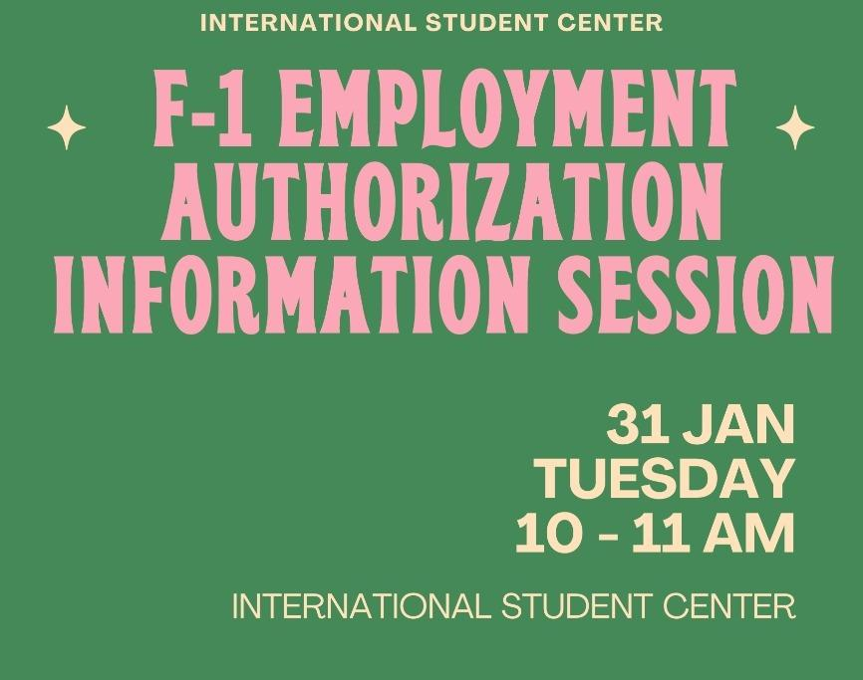
Employment
Friday, September 15th, 10:00 – 11:00 AM, ISC Lounge
Friday, 15 Sept

Slide 35
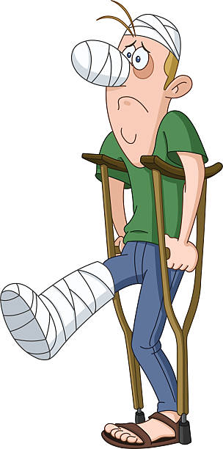
Health Insurance
Required for all SDSU international students
Fall 2023: Complete the health insurance requirement today!
Buy the pre-approved Fall 2023 or 2023-2024 at www.jcbins.com
Very few alternate health insurance policies are accepted (listed on ISC Forms webpage)
Holds added to your my.SDSU account if you do not buy coverage
Notes:
Health insurance is required as part of your immigration requirement. You should have purchased coverage by now. If not, you must do this today. You will need to buy the pre-approved health insurance policy through JCB Insurance Solutions for each semester.
The deadline for Fall 2022 is today! Buy the insurance at www.jcbins.com
Very few alternate health insurance policies are accepted, which are mainly for students who have a scholarship through their home government, such as Kuwait and Saudi Arabia–or students who will receive health insurance through their SDSU Assistantship position. View our Alternate Health Insurance Form for more information and to submit your request, if eligible. If you don’t qualify, you must buy the JCB insurance.
For Spring 2023 Registration: In October a hold will be added in your Webportal if you only bought the Fall insurance. Before you can register for Spring 2023 classes, you must buy the JCB insurance for Spring 2023 to get the international student hold removed. If there are other holds, you will need to get all holds removed so you can register. Please check your Webportal in early October and clear all the holds so you can register for Spring classes on your assigned day and time!

Slide 36
Immigration Document
Check

Slide 37
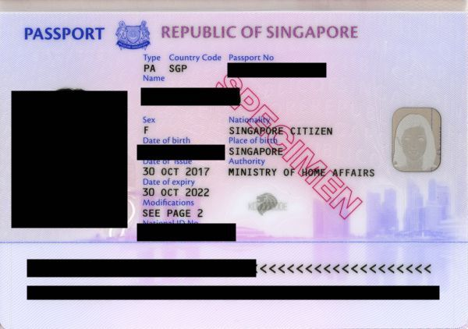
Immigration Documents:
Passport
Must be valid at all times (not expired)
Check expiration date regularly
If need to renew, contact your consulate or embassy in the U.S. or your home country's government > 6 months before it expires

Slide 38
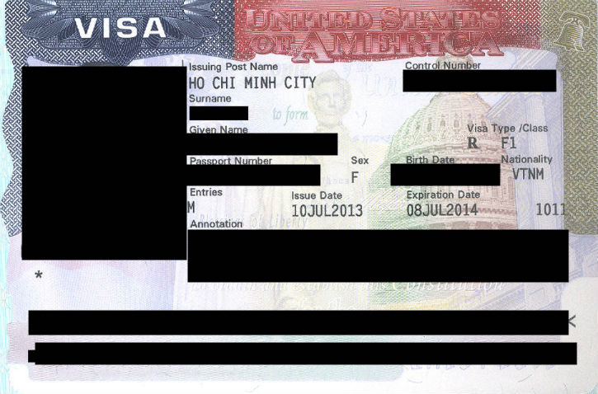
Immigration Documents:
F-1 Visa
A valid visa is required to enter the U.S.
After you have entered the U.S., you are allowed to stay even if visa expires, IF you’re maintaining F-1 status AND your I-20 is valid
International travel: F-1 visa must be valid on day of re-entry to the U.S.
F-1 visas can only be renewed at a U.S. Embassy or Consulate outside the U.S.
Your F-1 visa is not your I-20

Slide 39
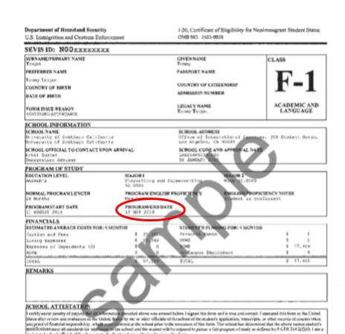
Immigration Documents: I-20
Form I-20 gives you legal F-1 immigration status in the U.S. if you follow all rules to maintain your status
Program End Date: don’t let this expire!
Travel signature on page 2 is valid for 1 year
If information changes (your name, major, program end date) or you need a new travel signature:
Request an updated I-20 via ISC website
Processing time = 7 business days

Slide 40
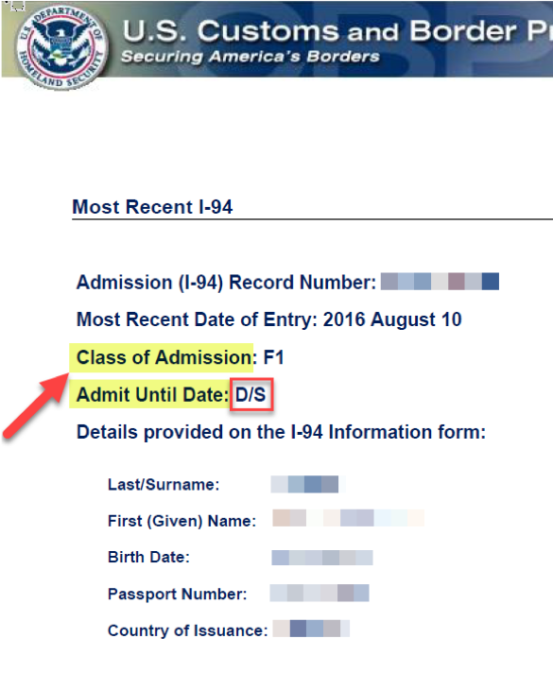
Immigration Documents: I-94
Take out your I-94 & check the following:
Most Recent Date of Entry:
Date you entered the U.S. (did customs processing)
Class of Admission:
Should say “F1”
Admit Until Date:
Should say “D/S” (Duration of Status)
Check your I-94 each time you travel internationally and re-enter!
If any of these items is incorrect, please email iscreception@sdsu.edu immediately for support.

Slide 41
Update Contact Info in my.SDSU
Mailing address is your US address in San Diego
Phone number is required (10 digits)
If don’t yet have a phone number, enter the ISC # (619) 594-1982 (update once you get your own number)
NEVER delete addresses/phone number in my.SDSU, only replace
SEVIS requires notification of address change within 10 days of moving
Notes:
As an F-1 international student in the US, the government requires you to keep them updated on where you live and how to get in touch with you at all times. You do this through your Web Portal account. We’re going to watch a video about how to do this in a second. There are a few address types to choose from in your Web Portal account. It’s important to select “Mailing Address” when entering in your US contact information, and make sure that it only has your US contact information, otherwise it will create an error in your immigration record. You will need to enter in a 10-digit US phone number. If you do not yet have a US phone number, enter in any random 10 digits and update that field as soon as you get a US phone number. Never remove your contact information from the Web Portal - only update it. Make sure you are following all of the prompts in the address and email section of your Web Portal and that you are saving/updating your information at the bottom. Any change in your contact information, like if you move to another address, must be updated in your Web Portal within 10 days, per SEVIS regulations.

Slide 42
Email Address Account
SDSU Policy:
All university communications must be sent via SDSU email
For I.T. support:
Computing Hub Help Desk
Love Library, 2nd Floor
(619) 594-3189
hub@sdsu.edu
Activate your SDSU email account
Check your SDSU email daily
Read important info and updates
Notes:
Each of you has been given an SDSU email account. This is the email address that SDSU offices use to communicate with you. It is your responsibility to check it each day for important information and updates. For example, if we update your I-20, we will email you that new document to your SDSU email account. Other offices will contact you for other important things, some of them with deadlines to respond or take action. Make sure you are checking AND READING your emails daily.

Slide 43
Marijuana: NOT legal for International Students (illegal)
F-1 Students must follow federal laws (higher than state laws)
California state law decriminalized marijuana, but federal law criminalizes marijuana (in all forms)
Illegal for you anywhere in the US
Consequences of using, having, distributing, working with, being around it:
Arrest
Deportation
Not allowed to re-enter the US
Not eligible to change to another visa status, green card, or citizenship
Alcohol Legal Drinking Age: 21-years-old
Notes:
How many of you were excited to come to California because marijuana was recently decriminalized? So, this will be very important for you to hear and understand, and this is pretty black and white. Even in California – everywhere in the US, actually – marijuana is completely illegal for international students under any circumstances. The reason is that you are here under federal – or national – US regulations. So, you must always follow federal law, which means that you cannot use, have, grow, distribute, or work with or even be around marijuana. Doing so risks arrest, deportation, a ban on returning to the US (sometimes for life), and not being able to change to any other visa status, get a green card, or US citizenship in the future.

Slide 44
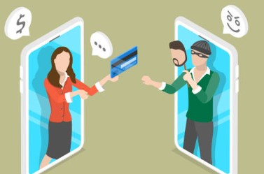
Beware of Scammers
If you receive a call or email like this:
Don’t panic
Hang up the phone / ignore the email
Don’t pay with cash, wire transfer, or gift card
Don’t give out personal information
Report call or email to the ISC & SDSU Police
Criminals target International Students by:
Calling or emailing
Pretending to be from the US gov’t (FBI, DHS, SSA, IRS)
Demanding money by threatening arrest
This is a scam
Notes:
Several students over the years were scammed out of a lot of money by criminals who target them through phone calls or emails. These criminals claim to be working with police or other government agencies, such the as the FBI, Department of Homeland Security, the Social Security Administration, or the IRS, among others. They pressured students to give them personal information and money through wire transfers or buying gift cards or else, they say, the students would get arrested or deported. The US government and police departments do not do this if they are legitimate. The people who do this are criminals. If you receive a call or email like this, first: don’t panic. This can feel very scary and stressful and urgent. Take a breath and remember that you know what to do in order to maintain your F-1 status, and that if there is a question or problem with your immigration record, we will discuss it with you and try to help you resolve it. So, hang up the call and don’t respond to the email, and definitely do not provide personal information or payment. Instead, contact the ISC and SDSU Police for assistance.

Slide 45
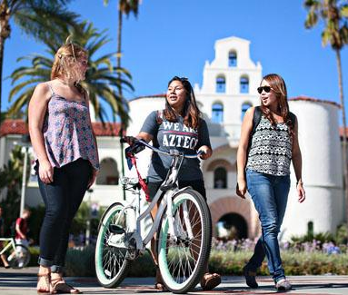
Maintaining Your Status Reminders
As an F-1 Student, you must:
Maintain full-time enrollment
Keep your I-20 valid
Keep your local address & phone updated
Follow rules for international travel
Maintain health insurance
Don’t work off-campus w/out ISC/US gov’t authorization
Meet w/ISC advisor if you wish to leave your program early or take a leave of absence
If you do not follow these regulations, you risk losing your F-1 status and may need to leave the U.S.!

