Slide 1
Welcome to
Fall 2023 Semester MSA Advising

Slide 2
Introduction

Slide 3
Part-time or Full-time
Based on Academic Schedule
Working full-time or other full-time commitment
-> Part-time (1-6 units per semester)
2-3 classes
Working 20 hours or less
-> Full-time (9 units+ per semester)
3 classes +
It’s all up to you!
(But remember you need to maintain a 3.0 GPA!)
Notes:
There is part time/full time for academic schedule and financial part time/full time is difference
7 units are charged full time but they are labeled part-time

Slide 4
Question # 1… What should I take?
Program of Study “formula”
Need to complete between 30-39 Units
Four Categories:
1. Prerequisites (3 mandatory)
ACCTG 620 Financial Measurement and Reporting
ACCTG 621 Accounting Information Systems
ACCTG 626 Audit and Assurance Services
2. Core Courses 13 units
3 Specializations/Electives 14 units:
Accounting Information Systems Track
Financial Reporting Track
Taxation Track
4. Culminating Experience 3 units

Slide 5
What Classes Do I Take First?
Rule of Thumb: Start with Prerequisites (if needed), then Core Courses then Specializations/Electives. Your Culminating Experience should be taken in your last semester.

Slide 6
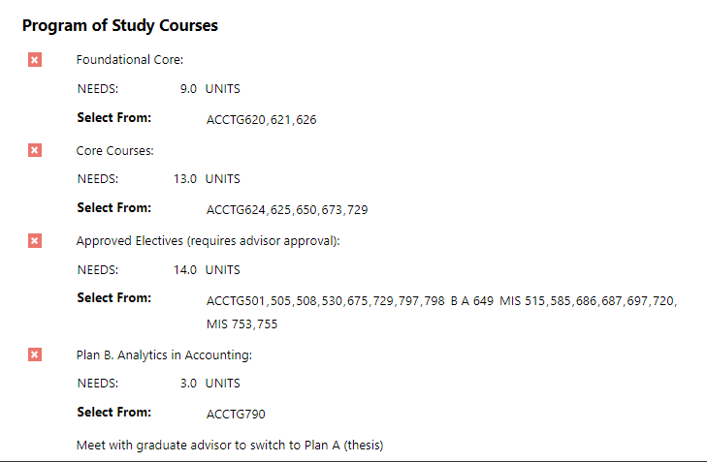
Degree audit
Notes:
https://business.sdsu.edu/graduate/msis
https://business.sdsu.edu/graduate

Slide 7
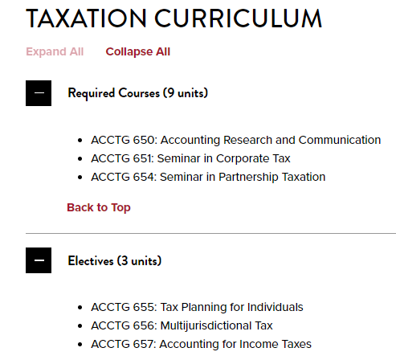
Taxation Advanced Certificate
To apply you should not have more than 50% of courses
Notes:
https://business.sdsu.edu/graduate/act
the process for adding a certificate program:
- Go to https://sdsuedu.sharepoint.com/sites/GRA/GA/SitePages/Forms.aspx
- Click on the dropdown for "advanced certificate program"
- Click on the link for "permission to enter an advanced certificate program​​

Slide 8
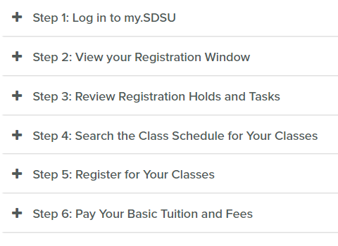
Question #2… How do I register?
Notes:
https://registrar.sdsu.edu/students/registration/mysdsu-registration-guide
Search by department class name and number
To Search for class syllabus: https://digitallibrary.sdsu.edu/islandora/object/sdsu%3A4996
https://registrar.sdsu.edu/academic-success/understanding-degree-evaluation

Slide 9
Question #3 What other things do I need to know before I start?
Steps to Enroll
Orientation
Academic Calendar/Money Matters
University referrals

Slide 10
Steps to Enroll
https://admissions.sdsu.edu/graduate/admitted
(Domestic Students)
https://admissions.sdsu.edu/international/graduate/admitted
(International Students)
Notes:
https://sacd.sdsu.edu/student-health-services
https://grad.sdsu.edu/current-students/insurance

Slide 11
Orientation
Friday, August 18
5:30pm to 8:00pm
Saturday, August 19
9:00am to 12:00pm
(8:30 check-in)

Slide 12
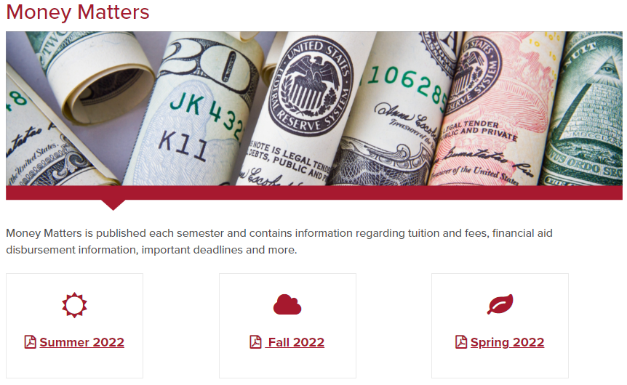
Academic Calendar Money Matters
Calendar found on Registrar’s website
registrar.sdsu.edu
Money Matters found on Student Account Services website
bfa.sdsu.edu/financial/student
Notes:
Admission Steps to Enroll: https://admissions.sdsu.edu/graduate/admitted
Student Account Services: https://student-accounts.sdsu.edu/about/contact
University Catalog: https://catalog.sdsu.edu/
Academic Calendar:https://registrar.sdsu.edu/calendars/academic_calendars

Slide 13
University Resources
Student Account Services | Student Services West 2536 | bfa.sdsu.edu/financial/student/contact
Veterans Center | SSW1661 | 619-594-5813 | veterans@sdsu.edu
International Student Center | International Affairs Complex | 619-594-1982 | iscreception@sdsu.edu
Registrar | SSW 1551 | 619-594-6871 | registrar@sdsu.edu
SDSU ID | SSW 2620 bfa.sdsu.edu/financial/student/sdsucard/get-a-card |  | sdsucard@sdsu.edu
Parking | bfa.sdsu.edu/campus/parkingtrans/parkingportal | 619 594-6671 | parking@sdsu.edu
?
Notes:
Jobs/ Assistantships:
https://sdsu.joinhandshake.com/login
https://sacd.sdsu.edu/career/students/job-search-resources/on-campus-job-opportunities
https://business.sdsu.edu/student/career
https://sacd.sdsu.edu/career/employers/career-fairs
GA/TA positions: Teaching associateships and graduate non-teaching assistantships in business administration are available to a limited number of qualified students. APPLICATION PROCEDURES OR HIRING UNIT CONTACT PERSON:If interested in a potential position in the Finance, Management, or Marketing departments, please forward the completed application, and supporting documents, to Stephanie Smith - stephanie.smith@sdsu.edu. If interested in a potential position in the School of Accountancy or MIS Department, please forward the completed application, and supporting documents, to Debra Woodman - dwoodman@sdsu.edu. Also, attach a copy of (1) your most recent SDSU transcript and (2) Program of Study (POS). The POS is needed only for students who have completed at least two semesters as a graduate student at SDSU.For more information, review the following:https://bfa.sdsu.edu/hr/jobs/student/gap/colbusiness This is an application that puts you in the search pool, but it does not guarantee them an assistantship position.
You can download the application for GA/TA positions using the following link. You can follow the instructions mentioned in the application to submit the same.
Graduate Assistant Application Teaching Associate Application (for Accountancy only)
You can also reach out to the Career Management Center for more information.

Slide 14
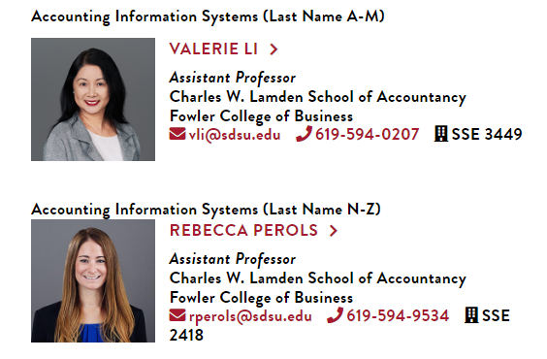
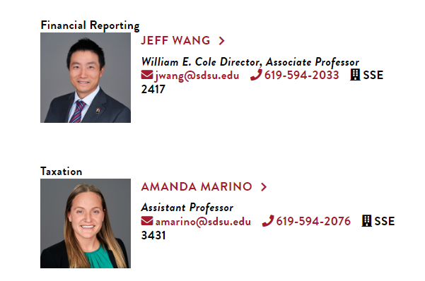
Contact Information
Notes:
Faculty Contact Information:https://business.sdsu.edu/graduate/grad-advising

